Slide 1
Urban Management For Smart Cities
A Java Swing Application
By
The Bug Slayers

Slide 2
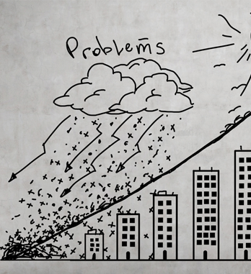
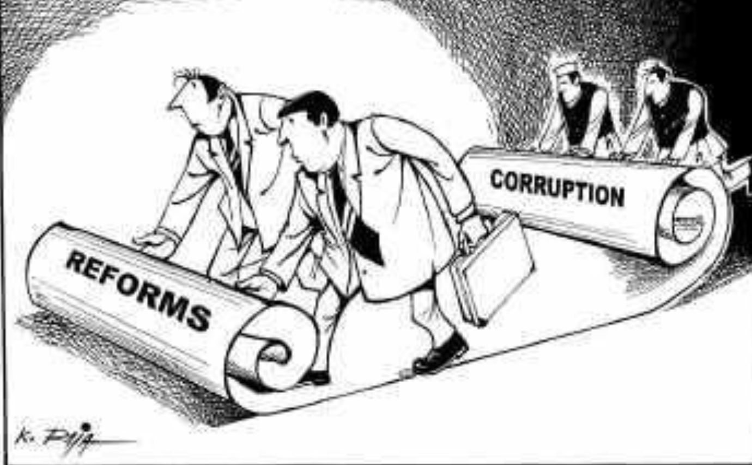
Problem Statement
Developing nations face a lot of problems in
Municipal Services
Emergency Services
Law Enforcement Services
These issues sometimes take a lot of time to resolve
Leads to further accidents/issues
Sometimes involves “Corruption”

Slide 3
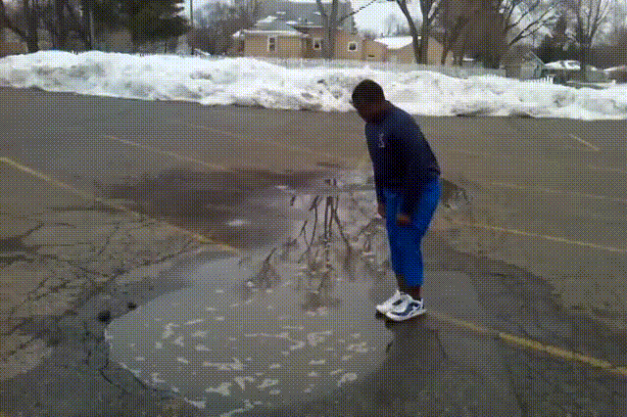

..Continued
An Example
Poor Roads in cities
As a taxpayer, every citizen should have the right to raise a complaint
Citizen should be able to track the request(Transparency)
Every department should be accountable to the tasks they have
There should be SLAs and KPIs as metrics

Slide 4
Solution
We want the citizens to:
Raise complaints
Municipal
Law and order
Track the status of Complaints
City Managers to get an overview of what is happening
Establish Deadlines to the known tasks

Slide 5
Approach / Application Architecture
Business Analysis
Every citizen will raise complaints in one specific city of his residence
Each city has own department that solve the issues
Multiple departments fall under one category e.g Under Municipal, Public Works(Construction Department) and Inventory, and many others
Architecture
Network - City
Enterprise - Municipal, Law Enforcement, etc
Organization - Municipal
Construction
Inventory
Finance
And so on

Slide 6
Use Cases
Single hop resolution complaints
Assigned to one organization and will be resolved by the same
E.g. when there is an issue with traffic, the user will raise a complaint to the traffic cop organization and the traffic cop will resolve the issue and mark it as complete
Multiple Hop resolution complaints
Assigned to one organization in an enterprise and will be resolved with the help of other organisations in the enterprise (dependency)
E.g. Road repair, => Construction => Inventory => Finance
Hop across Enterprises
Assigned to one organization will be dependant upon help with organizations from another enterprise
E.g. Water Pipeline burst => Water supply() => Traffic,to divert traffic(Law enforcement org)

Slide 7
Object Model
Link to the diagram

Slide 8
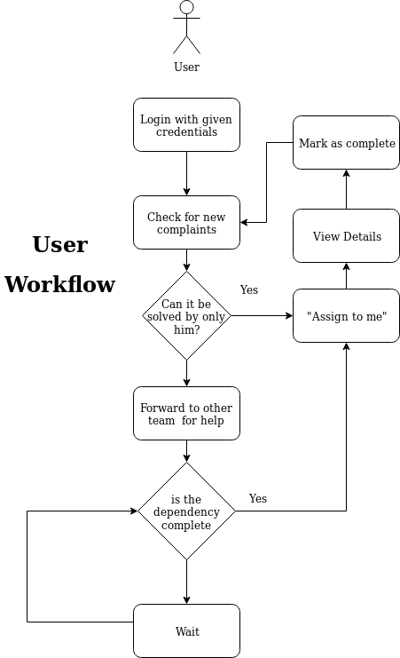
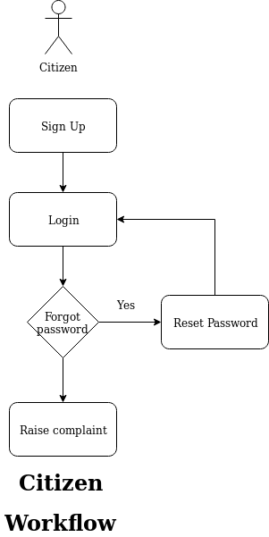
Workflow
Citizen Workflow:
Citizen will sign up => Login => Raise Complaint
User Workflow:
User will login => see the complaints and resolves

Slide 9
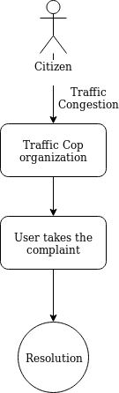
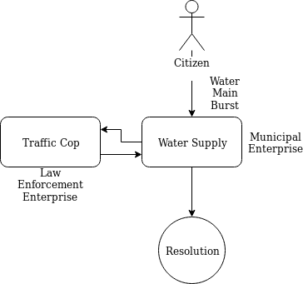
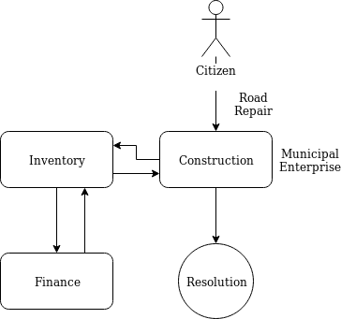
Request/Complaint Flow
Type 1
User from one organization resolves the request
Type 2
User forwards the request to another organization
Type 3
User forwards the request to another organization and further ahead

Slide 10
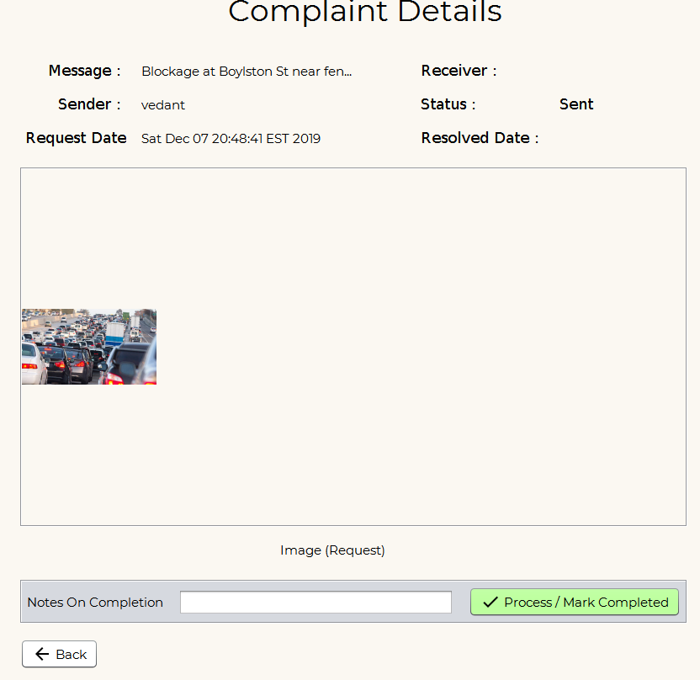
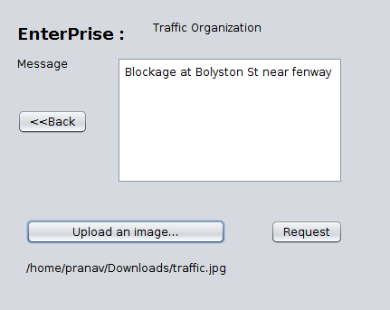
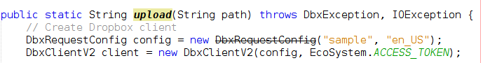
Additional Feature
Image upload Feature
Helps in better understanding of the complaint
Used - Dropbox Api for consistency instead of local storage
Dropbox Config Code
Citizen Uploads the picture with complaint message
User sees the image in view details

Slide 11
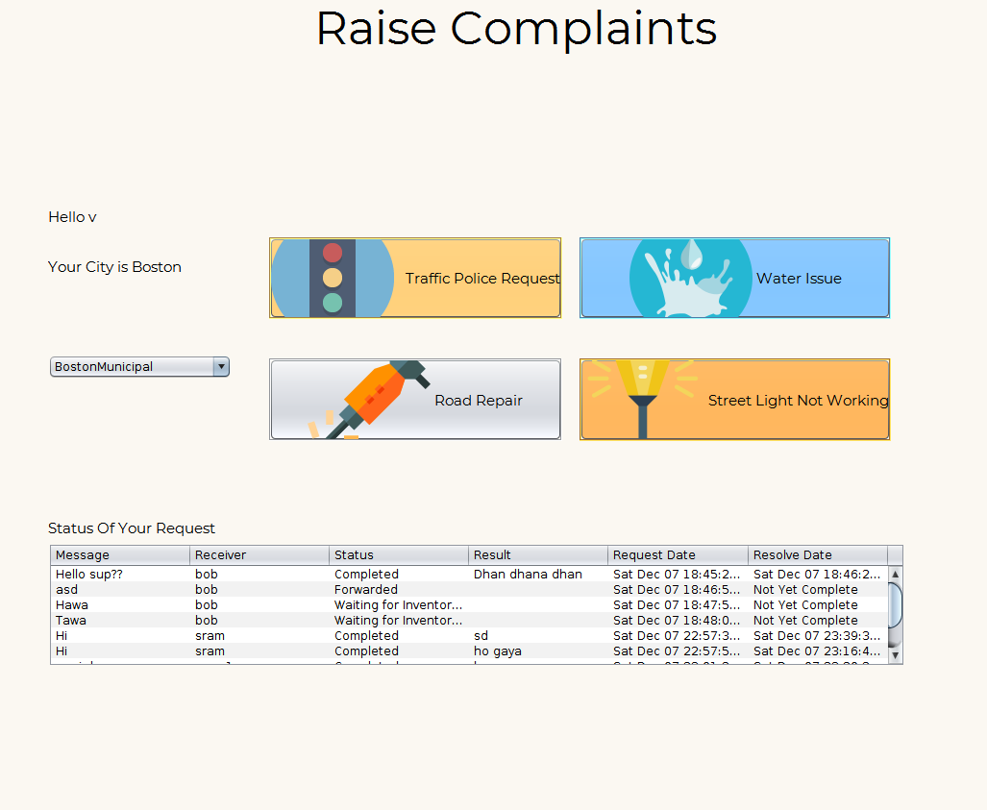
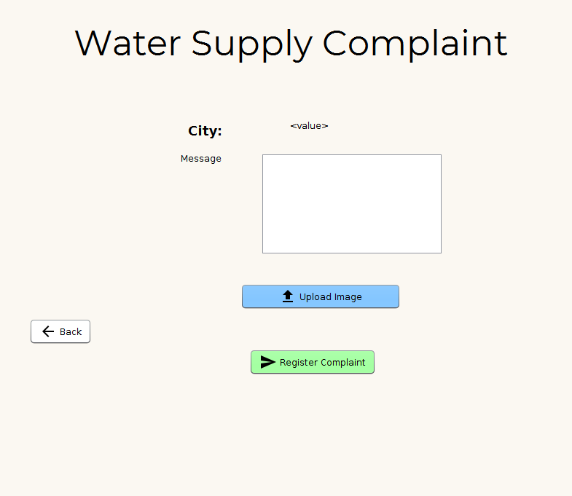
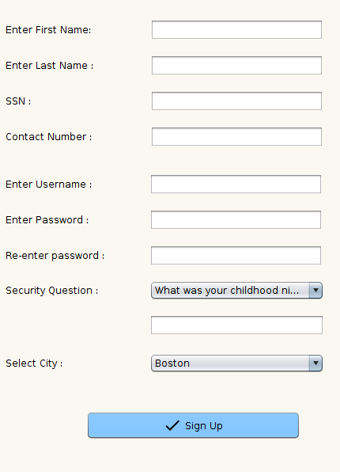
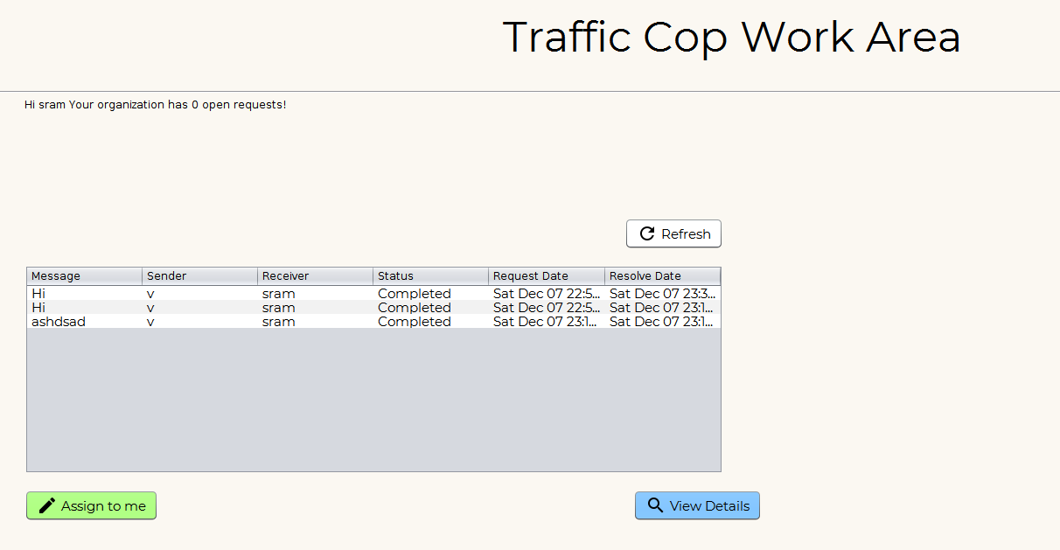
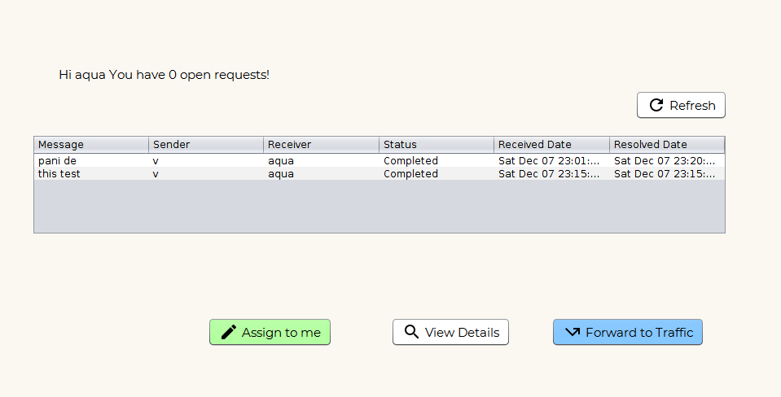
Screenshots
3. Water Supply Complaint
2. Raise Complaints
Sign up for citizen!
3. Forward to traffic (diff enterprise)
Shows up in Traffic

Slide 12
Thank you!

